Slide 1
Some of My Favorite Things
By: Sherika Session

Slide 2
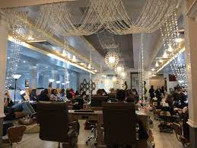
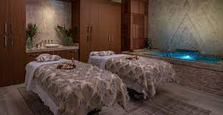
Oh How I LOVE……!
The Nail Salon
The Spa

Slide 3
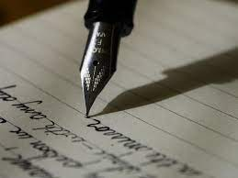
Oh How I LOVE……!
Shopping
Writing

Slide 4
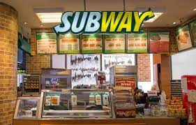
Ms. Session’s Favorite Fast Food Places
Chick-Fil-A
Subway

Slide 5
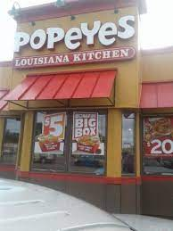
Ms. Session’s Favorite Fast Food Places (continued)
Dominos
Popeye's

Slide 6
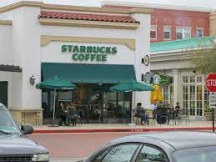
Other Favorites
Starbucks
Bahama Bucks

Slide 7
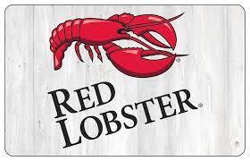
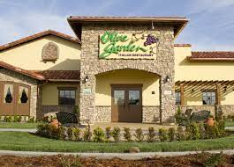
Ms. Session’s Favorite Restaurants
Red Lobster
Olive Garden

Slide 8
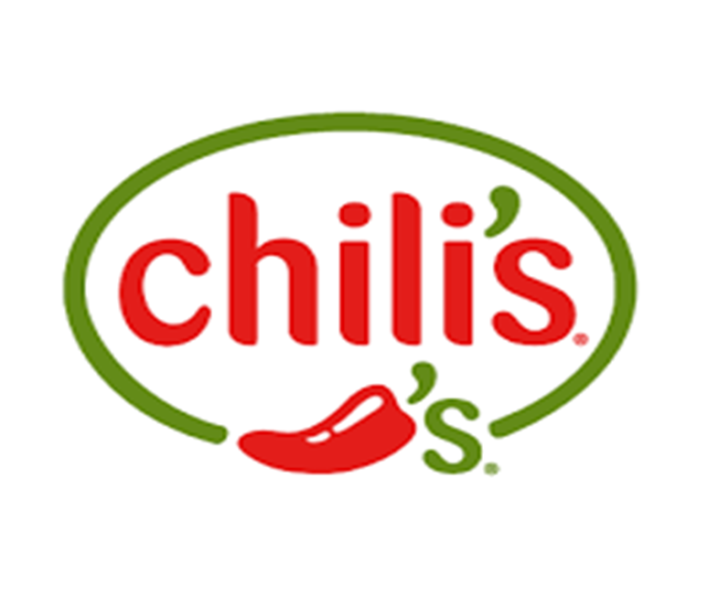
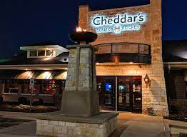
Ms. Session’s Favorite Restaurants
Cheddars
Chili’s

Slide 9
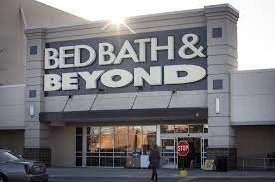
Ms. Session’s Favorite Stores
Bath & Body Works
Bed Bath & Beyond

Slide 10
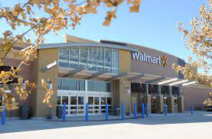
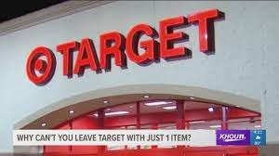
Ms. Session’s Favorite Stores
Walmart
Target

